Slide 1
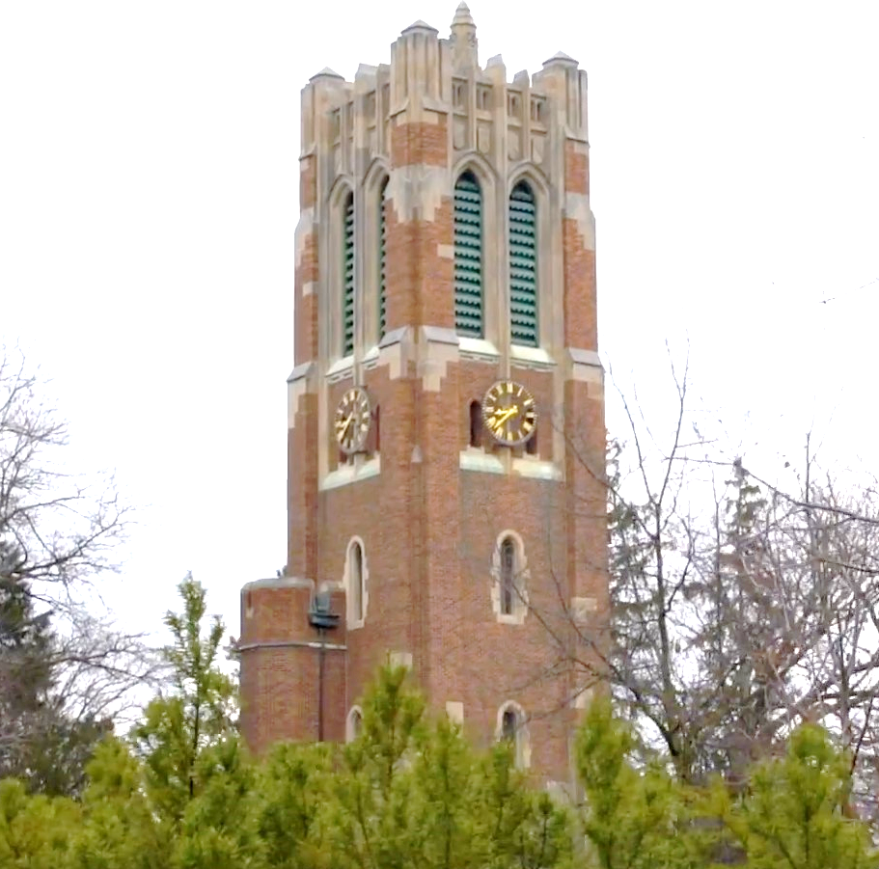
Optical wireless Sensing
Xiao Zhang
06/21/2023

Slide 2


RoFin: 3D Hand Pose Reconstructing
via 2D Rolling Fingertips
Authors: Xiao Zhang, Griffin Klevering, Juexing Wang，
Li Xiao，and Tianxing Li

Slide 3
Outline
Motivation
Rolling Shutter Effect
How RoFin Works?
System Design
Implementation
Evaluation
Conclusion

Slide 4
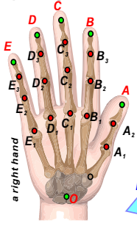
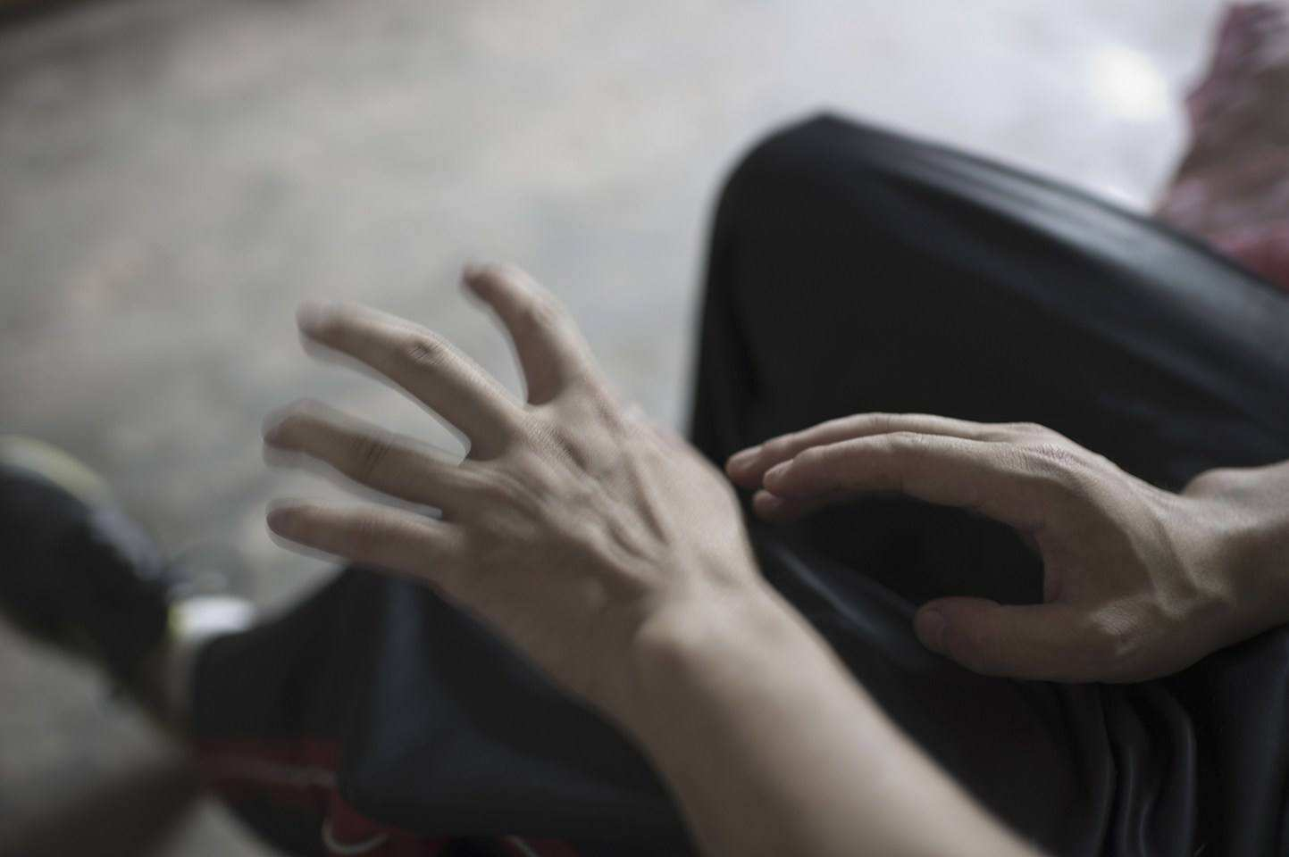
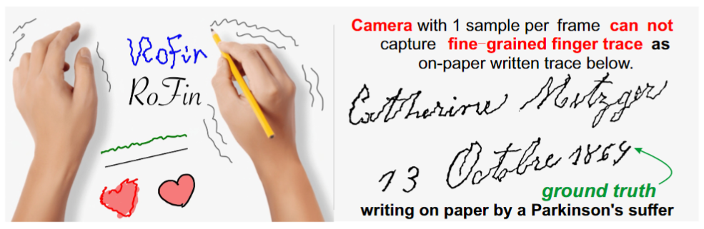
Motivation
Traditional CV method: coarse-grained finger tracking
Traditional hand pose reconstruction tracks numerous joints (i.e., 21)

Slide 5
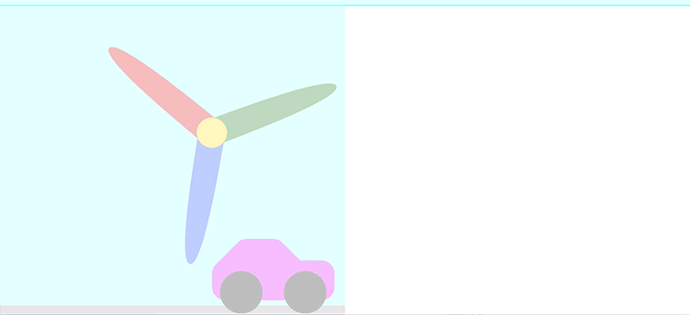
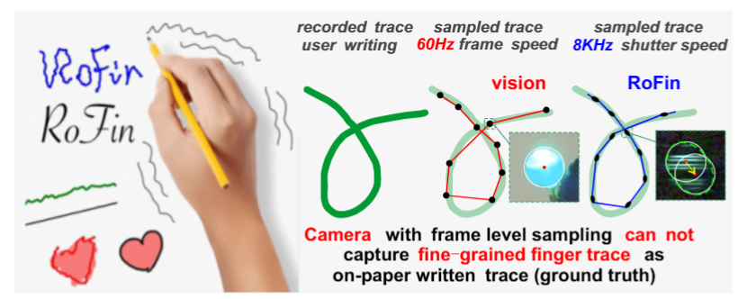
Rolling Shutter Effect
Sense the light row by row instead of frame by frame
Record more location samples in one frame instead of one sample

Slide 6
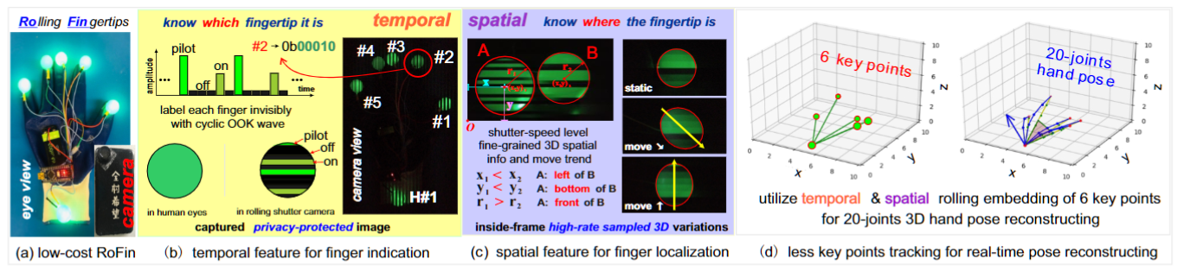
How RoFin works?
Active Optical Labeling for long distance finger & hand indication
Finer-grained Finger Tracking via faster sampling via rolling shutter
Real-Time Hand Pose Reconstructing via less tracked key joints

Slide 7
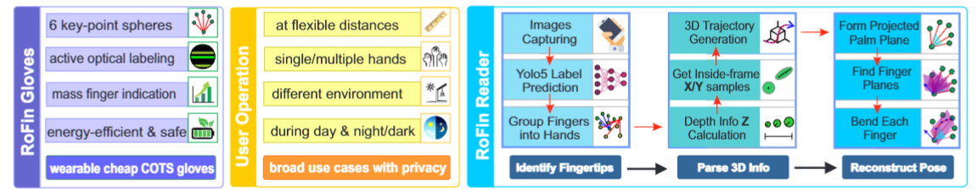
System Design
overview

Slide 8
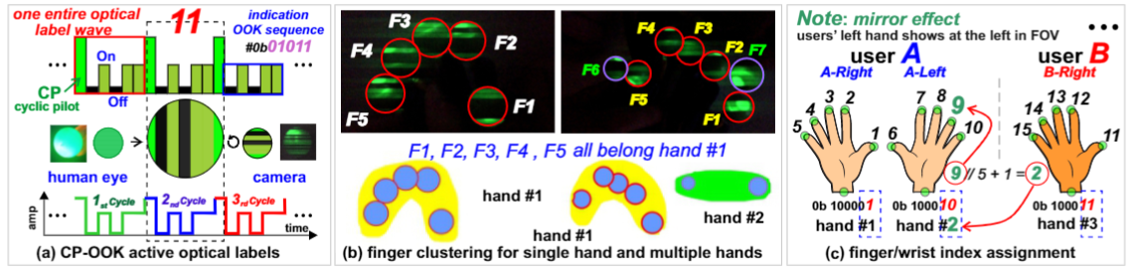
System Design
active optical labeling

Slide 9
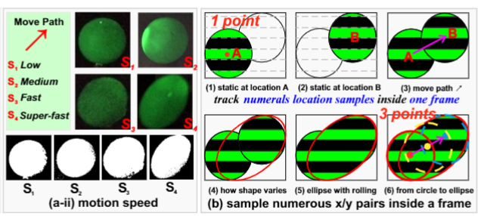
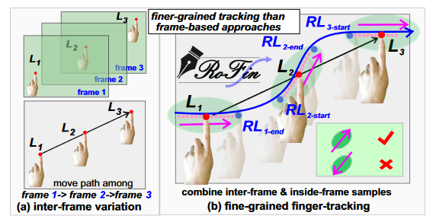
System Design
finer-grained finger tracking

Slide 10
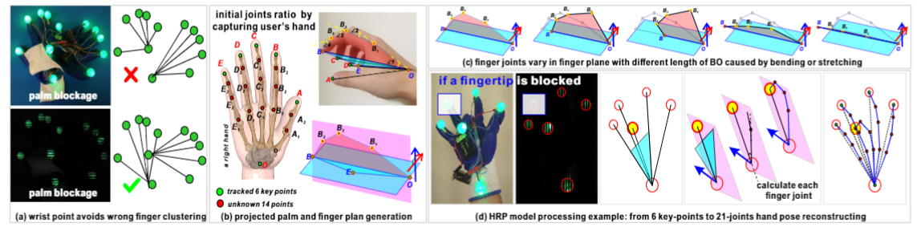
System Design
real-time hand pose reconstructing

Slide 11
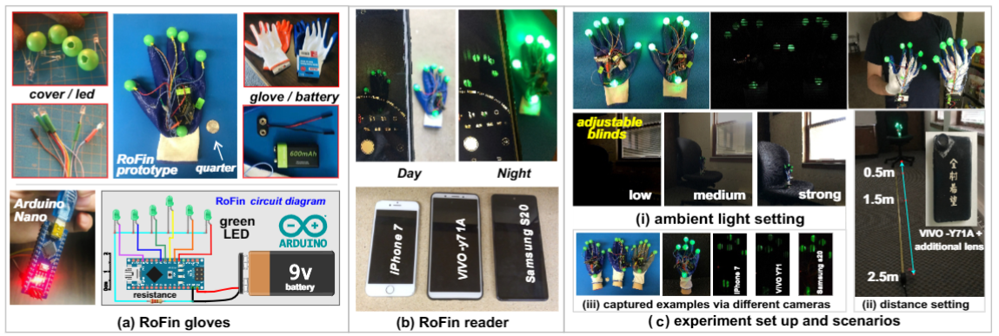
Implementation

Slide 12
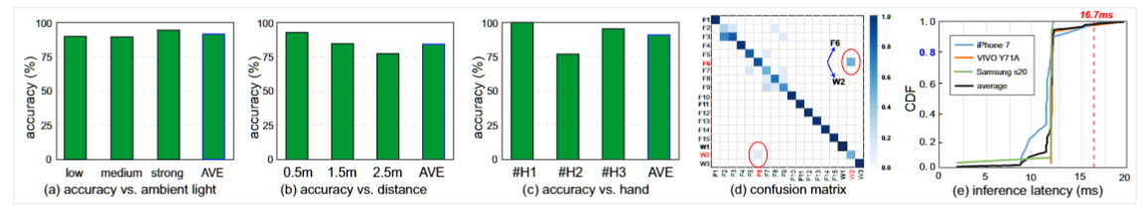
Evaluation
active optical labeling

Slide 13
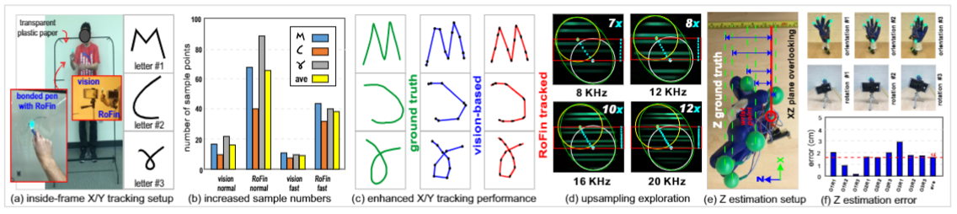
Evaluation
finer-grained finger tracking

Slide 14
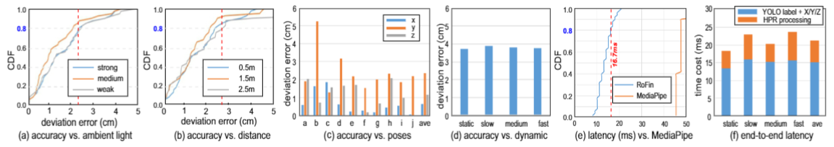
Evaluation
real-time hand pose reconstructing

Slide 15
Conclusion
exploit 2D temporal-spatial rolling to construct 3D hand pose
address technical challenges and implement RoFin prototype
achieve robust finger label parsing up to 2.5m
can sample up to 12X location samples than traditional CV
achieve real-time hand pose reconstruction with 16 mm mean deviation error

Slide 16
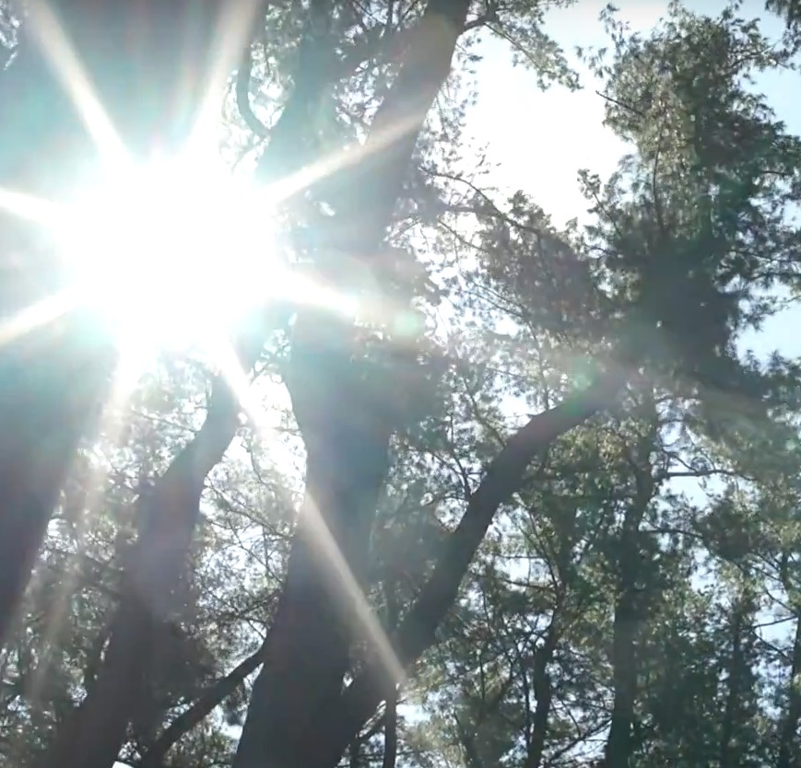
Q & A thank you
E-MAIL: zhan1387@msu.edu

